Slide 1

OOP
Object Oriented Programming
Lecture 13
Lecture 1

Slide 2
Outline
Composition

Slide 3
Composition
Composition in Object-Oriented Programming (OOP) is a design principle where a class is composed of one or more objects from other classes. It's often described as a "has-a" relationship.
Key Features:
Reusability: Objects of existing classes can be reused.
Encapsulation: The containing class manages its composed objects.
Flexibility: Behaviors can be changed by using different objects in composition.

Slide 4
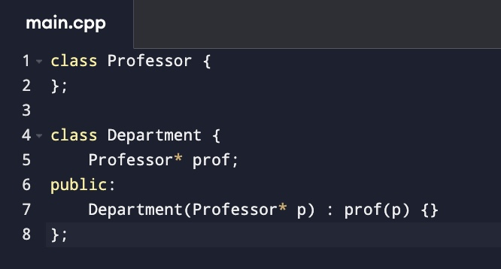
Aggregation vs. Composition
Both composition and aggregation represent "has-a" relationships in OOP, but they differ in the strength of ownership and lifecycle dependency between the objects. Here's a clear distinction:
1.) Aggregation (Weaker Relationship)
In aggregation, the containing class (whole) and its parts have an independent lifecycle. If the container object is destroyed, the part objects can still exist.
Example: A Department has Professors. Even if the department is deleted, professors can still exist.

Slide 5
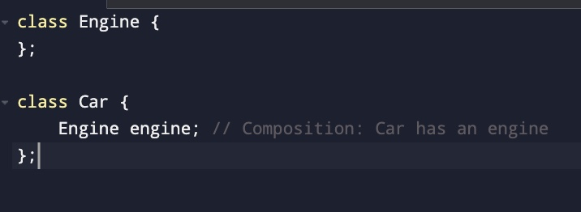
Aggregation vs. Composition
Both composition and aggregation represent "has-a" relationships in OOP, but they differ in the strength of ownership and lifecycle dependency between the objects. Here's a clear distinction:
2.) Composition (Stronger Relationship)
In composition, the parts are tightly coupled with the container. If the container object is destroyed, its part objects are also destroyed.
Example: A Car has an Engine. If the car is destroyed, the engine does not make sense alone.

Slide 6
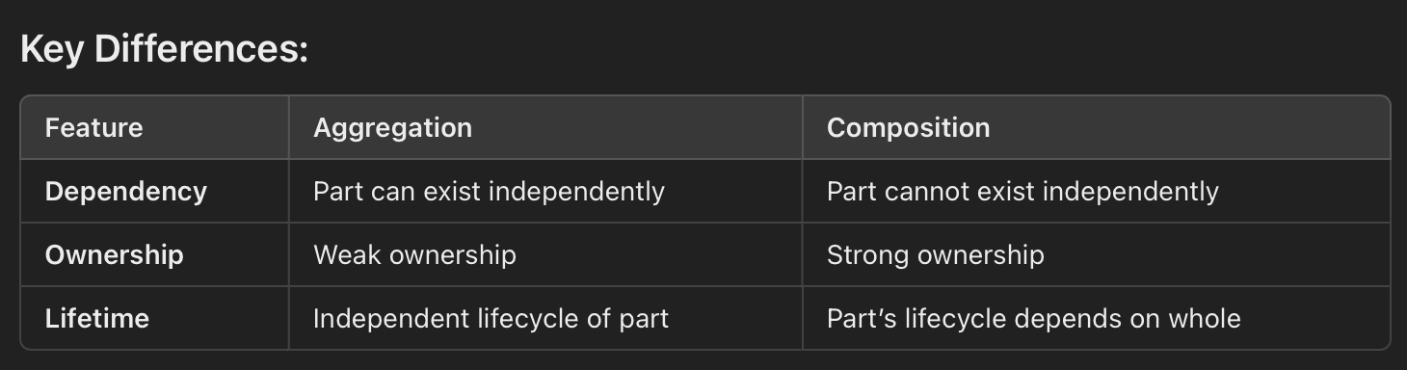
Key Difference

Slide 7
What is Composition in OOP?
Think of your favorite toy car. It’s made up of smaller parts like wheels, doors, and an engine. Each part has its own job, but together, they make a working car.
In Object-Oriented Programming (OOP), composition is like that toy car. One class is made up of objects of other classes. Instead of inheriting (getting everything from a parent class), you build a class by using other classes as parts.
Example in C++
Let’s imagine a Car class. A car has a Engine and Wheel. These are separate parts but together make the car functional. (Implement this)

Slide 8
Another Scenerio
Example from Real Life:
Think about a Computer. A computer:
Has a CPU
Has a Monitor
Has a Keyboard
Each of these components (CPU, Monitor, Keyboard) can work independently, but together they form a functioning computer.

Slide 9
Key Features of Composition:
1. Reusability
You don’t need to rewrite the logic for each part inside the Computer. Instead:
You create separate CPU, Monitor, and Keyboard classes.
These can be used in multiple places. For instance:
A Laptop also has a CPU and Monitor.
A Desktop has the same.
This makes your code modular and easy to reuse.

Slide 10
Key Features of Composition:
2. Encapsulation
Encapsulation means hiding the details of the components.
The Computer class manages the CPU, Monitor, and Keyboard objects internally.
External code only interacts with Computer:
It doesn’t need to know how the CPU starts or how the Monitor displays.
This keeps things simple for users of the Computer class.

Slide 11
3. Flexibility
You can change the behavior by swapping parts.
For example:
If you want a more powerful computer, you can replace the CPU object with a faster one.
If you want a gaming setup, you could swap out the Monitor for a high-refresh-rate model.
You don't need to rewrite the entire Computer class; just replace its components.

Slide 12
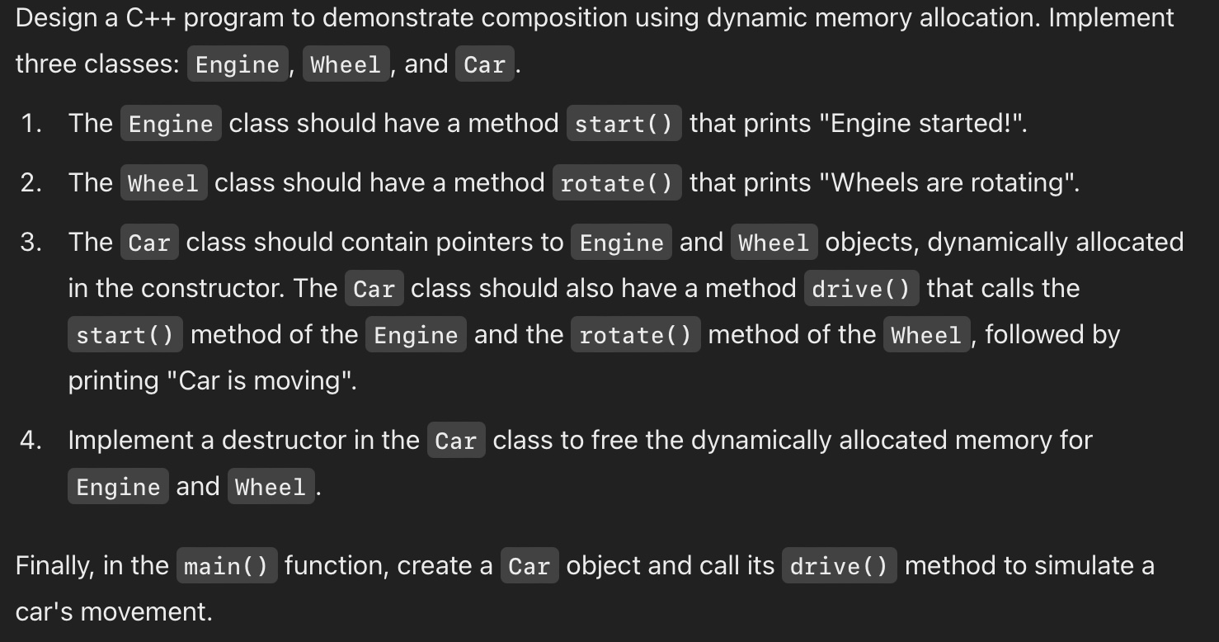
Problem 3

Slide 13
Let’s apply this understanding to code:

Slide 14
End of Lecture

